Slide 1
How To Access Stencyl Crash Course Kit
By Cooper Anderson 2018

Slide 2
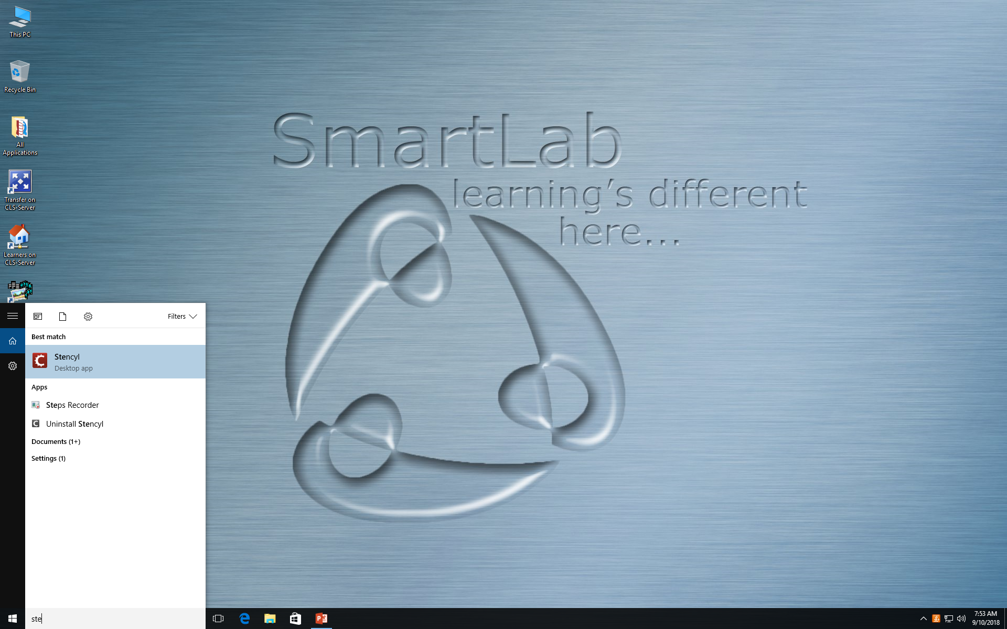
On the lower left hand side type “Stencyl”

Slide 3
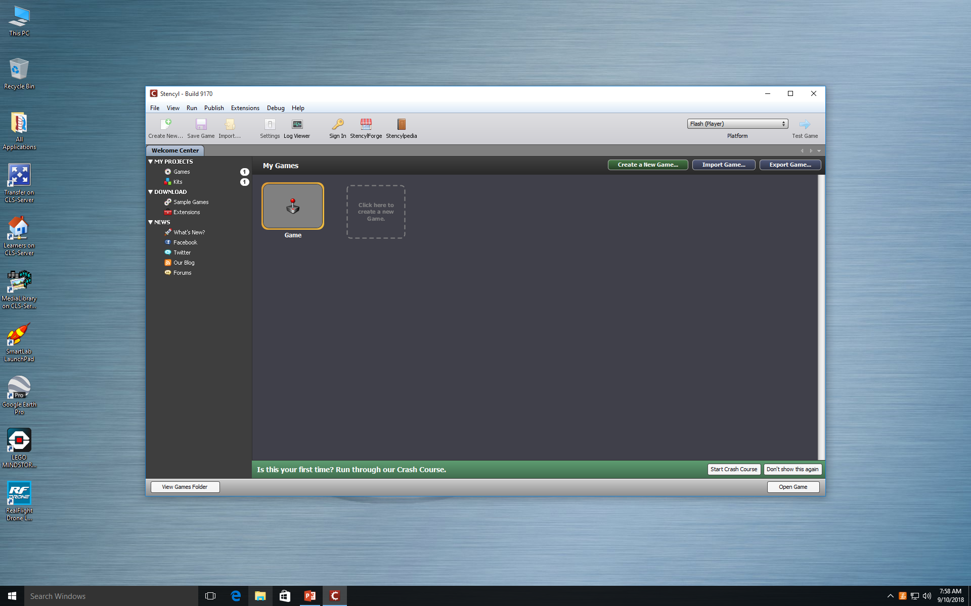
You should now be on this screen

Slide 4
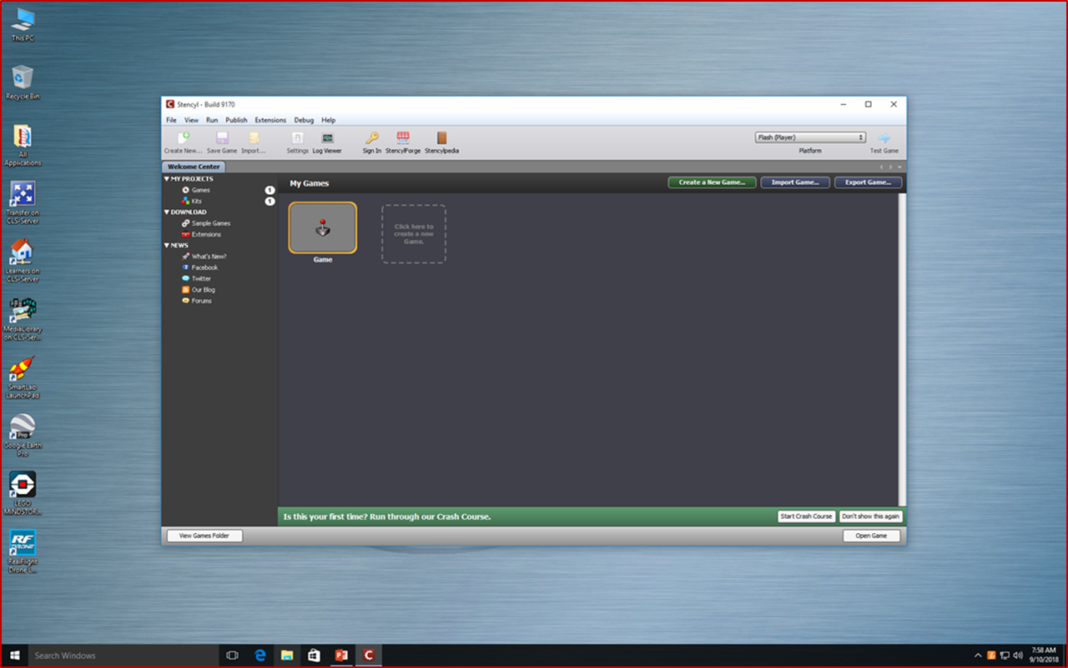
Once you on the stencil page click Stencylpedia on the top

Slide 5
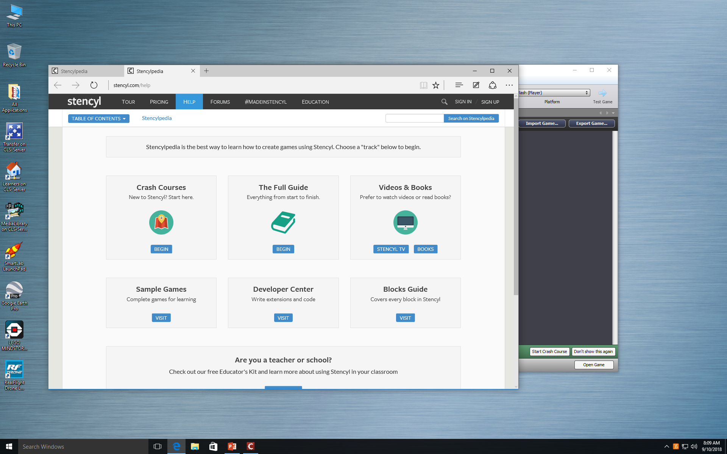
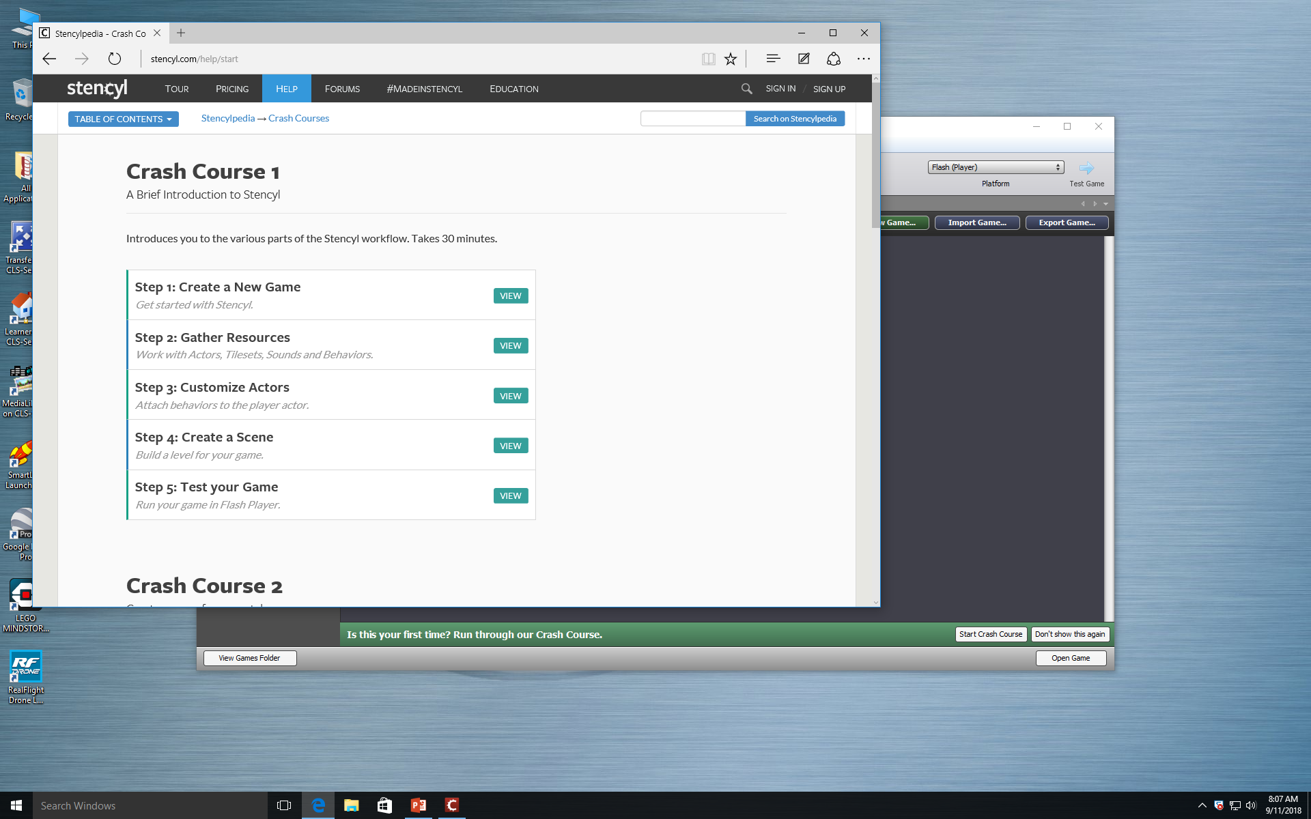
Now Click begin on Crash Courses
Then click Create New Game

Slide 6
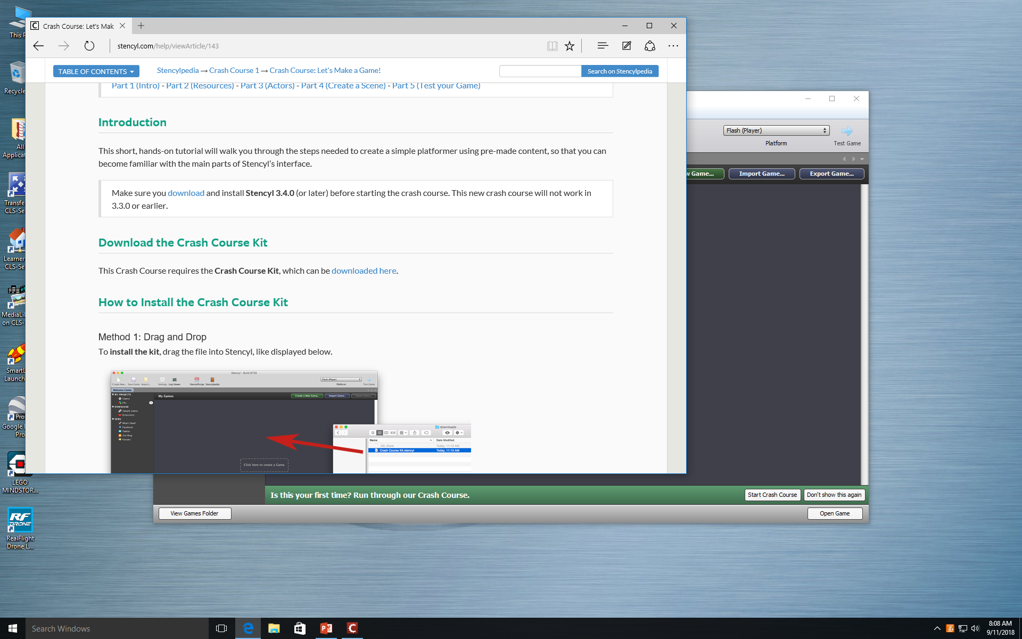
Once you Click on Create New Game Scroll down to Download The Crash Course Kit and click on the link

Slide 7
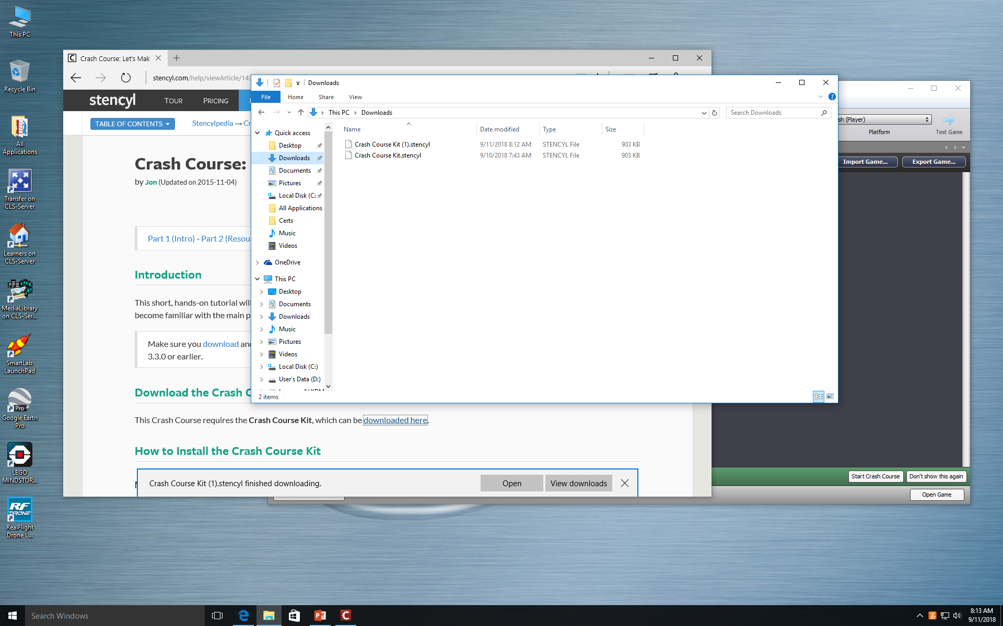
Your Crash Course Kit will be here
Step 1: Don't click open.
Step 2: Go to File, Then Click Downloads.

Slide 8
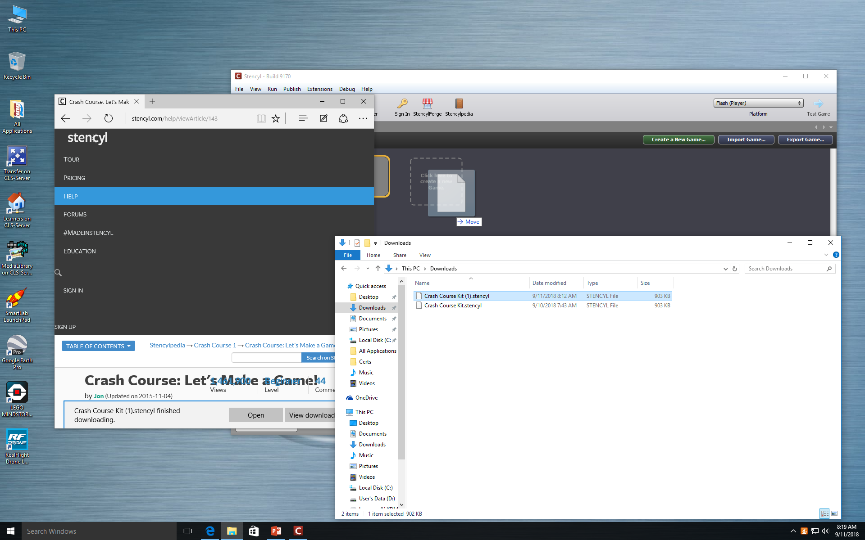
Then you are going to click and drag your kit into the Blank box.

Slide 9
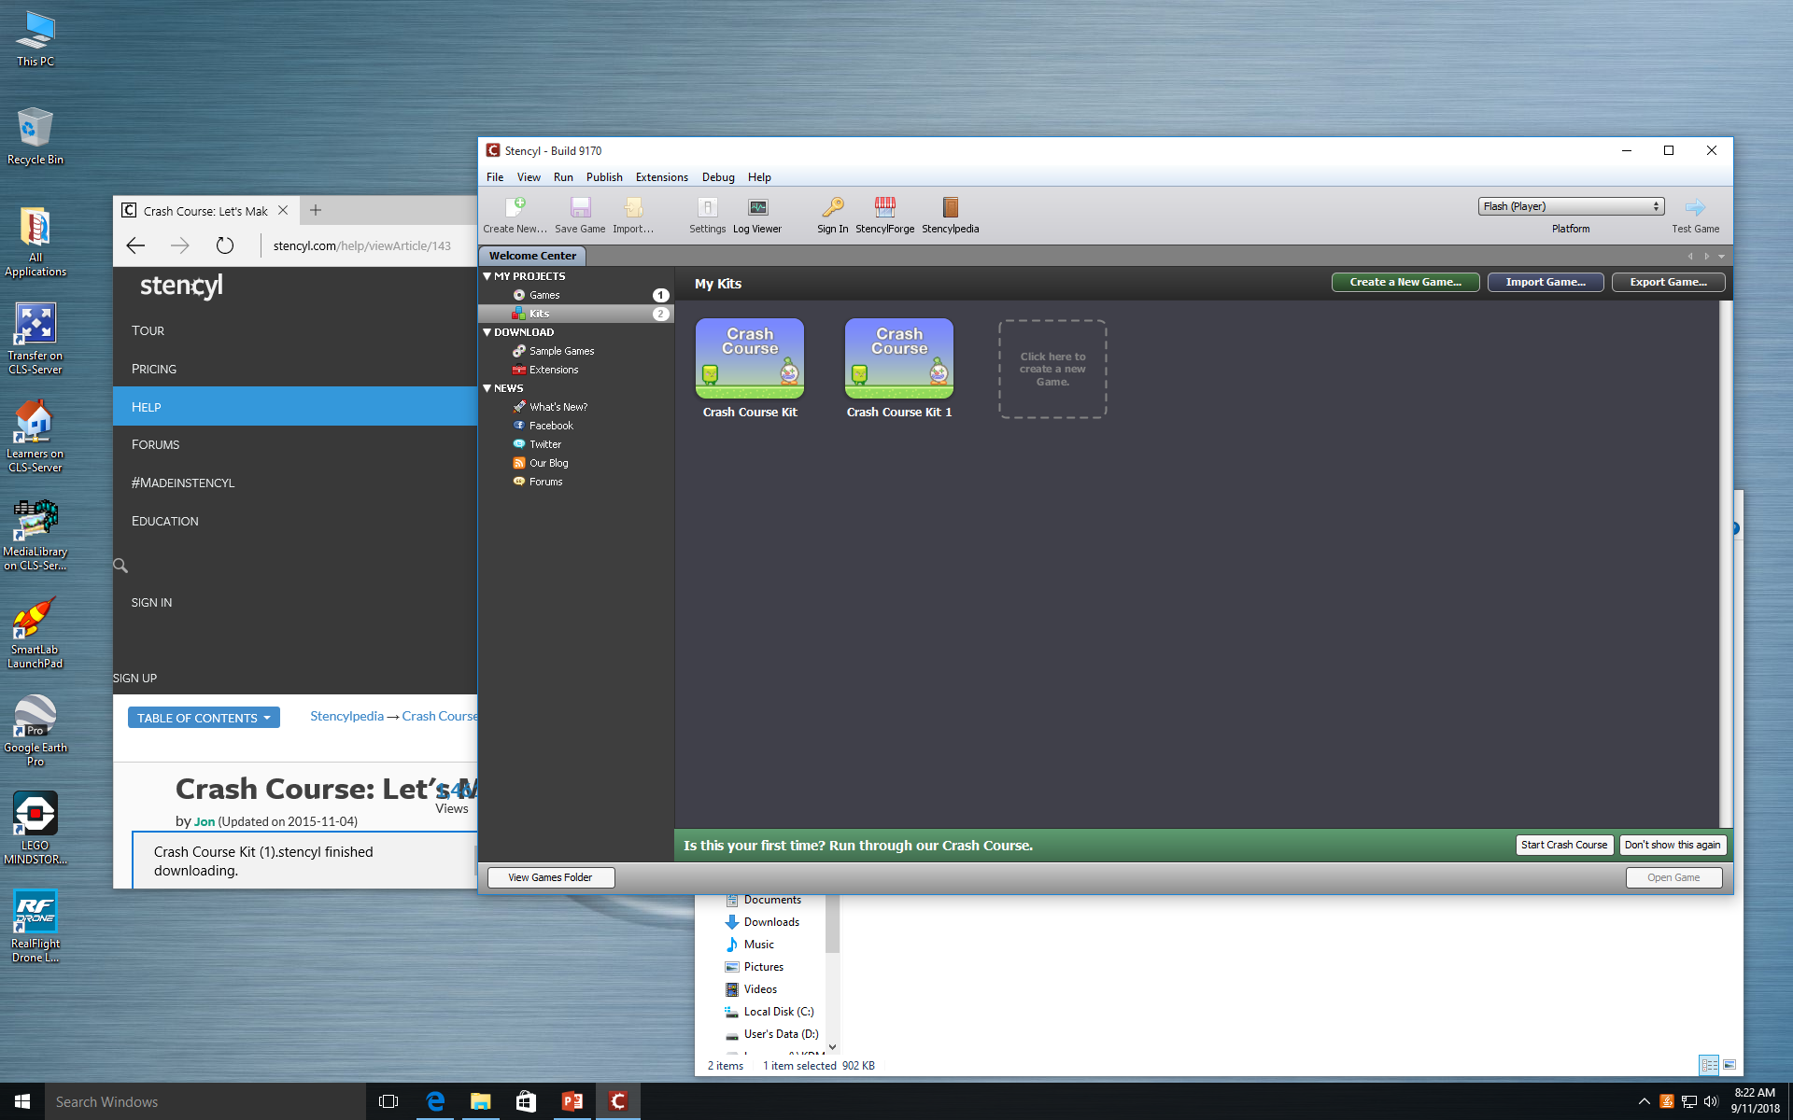
Finally you will look at My Projects, Then Click on Kits.

